Slide 1
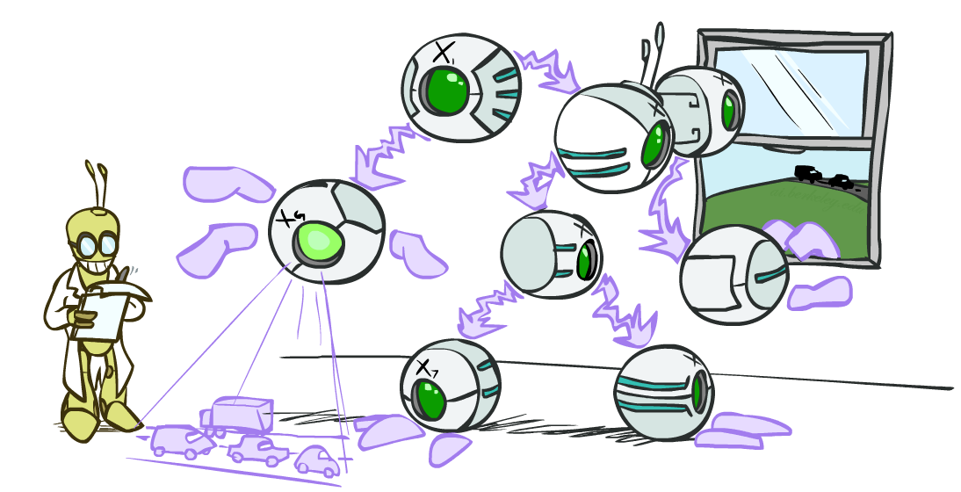
CSE 317: Artificial Intelligence
Bayes’ Nets: Inference
[These slides were created by Dan Klein and Pieter Abbeel for CS188 Intro to AI at UC Berkeley. All CS188 materials are available at http://ai.berkeley.edu.]
Notes:
Please retain proper attribution, including the reference to ai.berkeley.edu. Thanks!

Slide 2
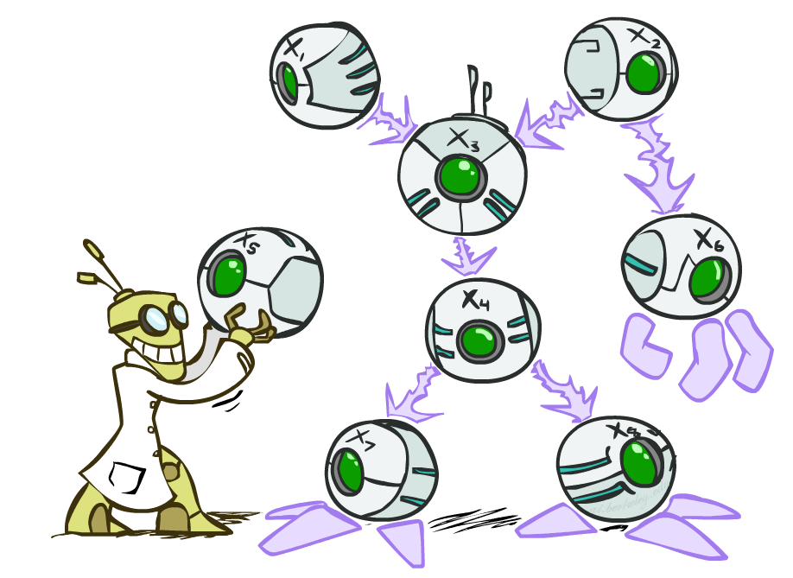

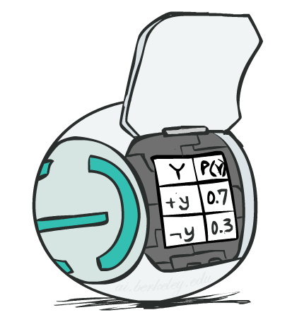
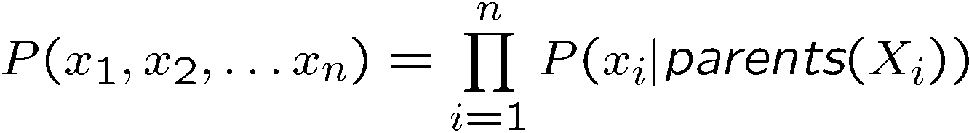
Bayes’ Net Representation
A directed, acyclic graph, one node per random variable
A conditional probability table (CPT) for each node
A collection of distributions over X, one for each combination of parents’ values
Bayes’ nets implicitly encode joint distributions
As a product of local conditional distributions
To see what probability a BN gives to a full assignment, multiply all the relevant conditionals together:

Slide 3
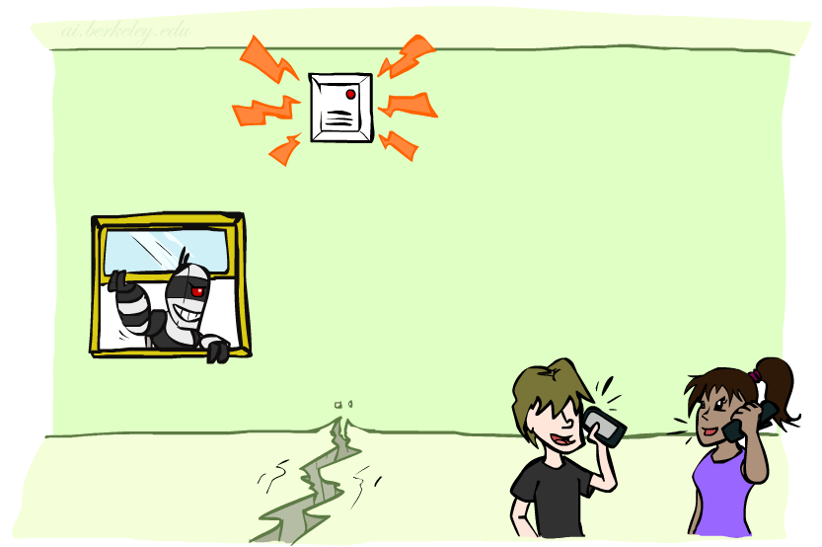
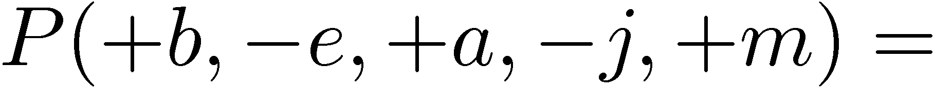
Example: Alarm Network
B | P(B)
+b | 0.001
-b | 0.999
B
E
E | P(E)
+e | 0.002
-e | 0.998
A
A | J | P(J|A)
+a | +j | 0.9
+a | -j | 0.1
-a | +j | 0.05
-a | -j | 0.95
A | M | P(M|A)
+a | +m | 0.7
+a | -m | 0.3
-a | +m | 0.01
-a | -m | 0.99
B | E | A | P(A|B,E)
+b | +e | +a | 0.95
+b | +e | -a | 0.05
+b | -e | +a | 0.94
+b | -e | -a | 0.06
-b | +e | +a | 0.29
-b | +e | -a | 0.71
-b | -e | +a | 0.001
-b | -e | -a | 0.999
J
M
Notes:
demo

Slide 4

Example: Alarm Network
B | P(B)
+b | 0.001
-b | 0.999
B
E
E | P(E)
+e | 0.002
-e | 0.998
A
A | J | P(J|A)
+a | +j | 0.9
+a | -j | 0.1
-a | +j | 0.05
-a | -j | 0.95
A | M | P(M|A)
+a | +m | 0.7
+a | -m | 0.3
-a | +m | 0.01
-a | -m | 0.99
B | E | A | P(A|B,E)
+b | +e | +a | 0.95
+b | +e | -a | 0.05
+b | -e | +a | 0.94
+b | -e | -a | 0.06
-b | +e | +a | 0.29
-b | +e | -a | 0.71
-b | -e | +a | 0.001
-b | -e | -a | 0.999
J
M
Notes:
demo

Slide 5

Bayes’ Nets
Representation
Conditional Independences
Probabilistic Inference
Enumeration (exact, exponential complexity)
Variable elimination (exact, worst-case exponential complexity, often better)
Inference is NP-complete
Sampling (approximate)
Learning Bayes’ Nets from Data

Slide 6

Inference
Inference: calculating some useful quantity from a joint probability distribution
Examples:
Posterior probability
Most likely explanation:

Slide 7





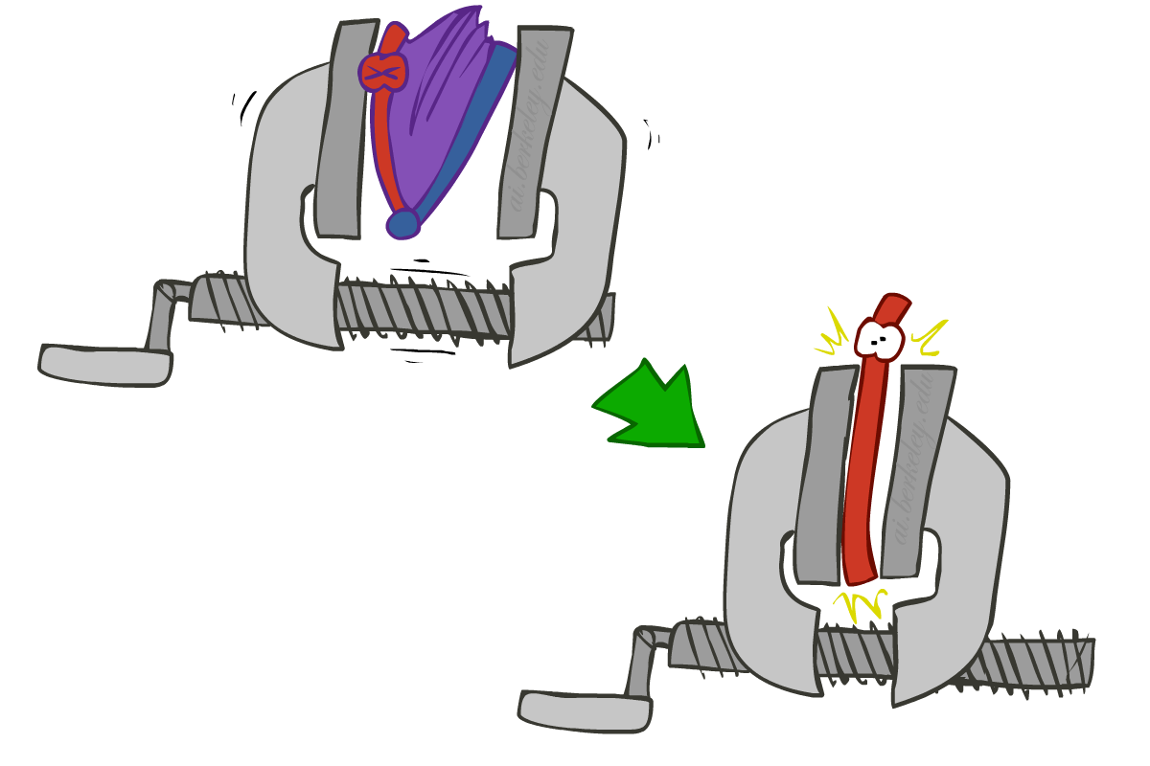
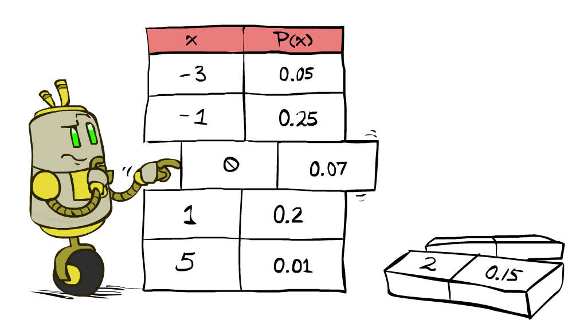


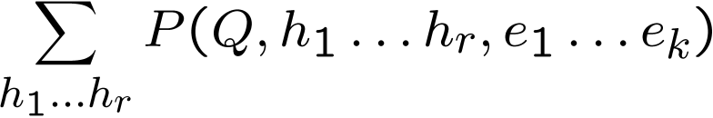
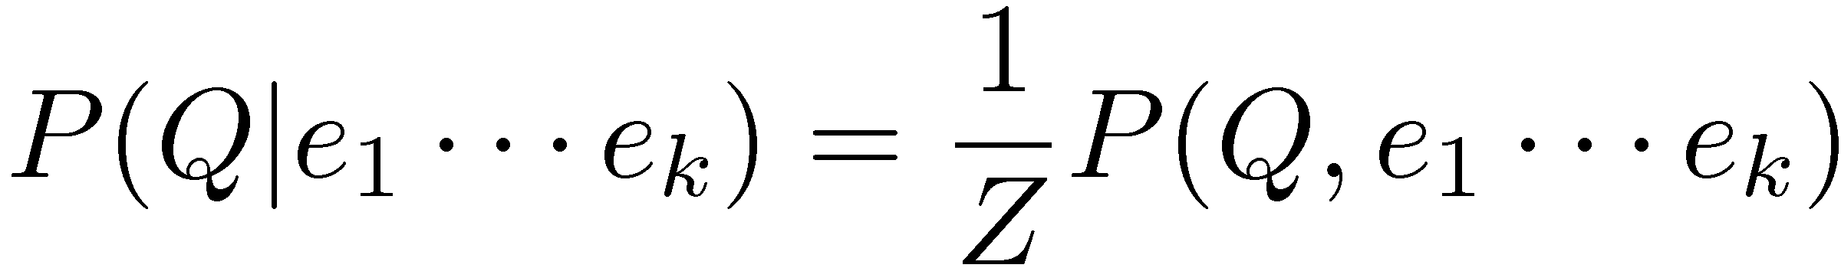
Inference by Enumeration
* Works fine with multiple query variables, too
General case:
Evidence variables:
Query* variable:
Hidden variables:
We want:
All variables
Step 1: Select the entries consistent with the evidence
Step 2: Sum out H to get joint of Query and evidence
Step 3: Normalize

Slide 8
Inference by Enumeration in Bayes’ Net
Given unlimited time, inference in BNs is easy
Reminder of inference by enumeration by example:
B
E
A
J
M

Slide 9
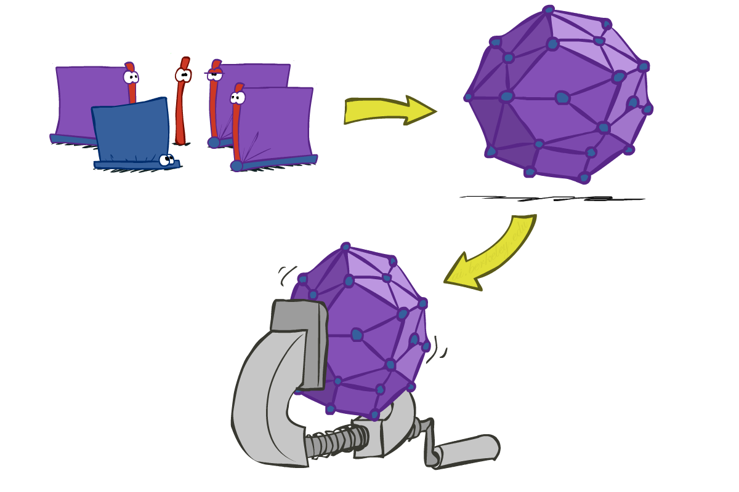
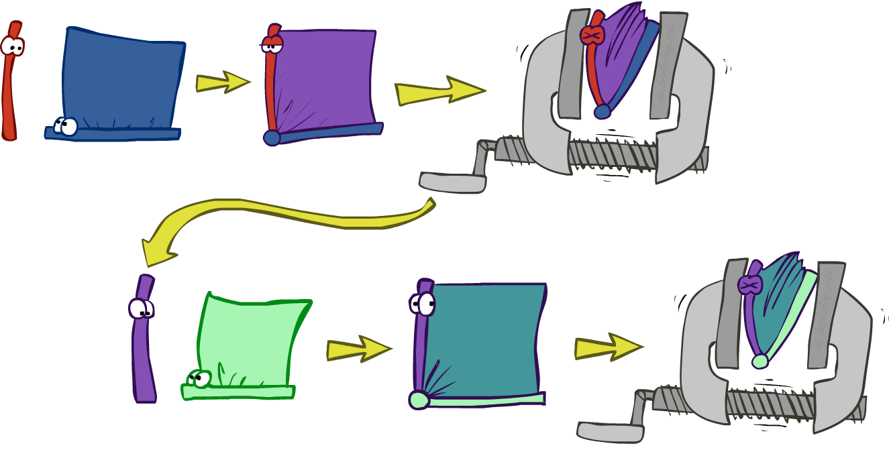
Inference by Enumeration vs. Variable Elimination
Why is inference by enumeration so slow?
You join up the whole joint distribution before you sum out the hidden variables
Idea: interleave joining and marginalizing!
Called “Variable Elimination”
Still NP-hard, but usually much faster than inference by enumeration
First we’ll need some new notation: factors

Slide 10



Example: Traffic Domain
Random Variables
R: Raining
T: Traffic
L: Late for class!
+r | 0.1
-r | 0.9
R
T
+r | +t | 0.8
+r | -t | 0.2
-r | +t | 0.1
-r | -t | 0.9
L
+t | +l | 0.3
+t | -l | 0.7
-t | +l | 0.1
-t | -l | 0.9

Slide 11

Variable Elimination (VE)

Slide 12







Inference by Enumeration: Procedural Outline
Track objects called factors
Initial factors are local CPTs (one per node)
Any known values are selected
E.g. if we know , the initial factors are
Procedure: Join all factors, then eliminate all hidden variables
+r | 0.1
-r | 0.9
+r | +t | 0.8
+r | -t | 0.2
-r | +t | 0.1
-r | -t | 0.9
+t | +l | 0.3
+t | -l | 0.7
-t | +l | 0.1
-t | -l | 0.9
+r | 0.1
-r | 0.9
+r | +t | 0.8
+r | -t | 0.2
-r | +t | 0.1
-r | -t | 0.9
+t | +l | 0.3
-t | +l | 0.1

Slide 13





Operation 1: Join Factors
First basic operation: joining factors
Combining factors:
Just like a database join
Get all factors over the joining variable
Build a new factor over the union of the variables involved
Example: Join on R
Computation for each entry: pointwise products
R
+r | 0.1
-r | 0.9
+r | +t | 0.8
+r | -t | 0.2
-r | +t | 0.1
-r | -t | 0.9
+r | +t | 0.08
+r | -t | 0.02
-r | +t | 0.09
-r | -t | 0.81
R,T
T

Slide 14

Example: Multiple Joins

Slide 15



Example: Multiple Joins
+r | 0.1
-r | 0.9
R
Join R
Join T
+r | +t | 0.08
+r | -t | 0.02
-r | +t | 0.09
-r | -t | 0.81
R, T, L
T
+r | +t | 0.8
+r | -t | 0.2
-r | +t | 0.1
-r | -t | 0.9
R, T
+r | +t | +l | 0.024
+r | +t | -l | 0.056
+r | -t | +l | 0.002
+r | -t | -l | 0.018
-r | +t | +l | 0.027
-r | +t | -l | 0.063
-r | -t | +l | 0.081
-r | -t | -l | 0.729
L
L
+t | +l | 0.3
+t | -l | 0.7
-t | +l | 0.1
-t | -l | 0.9
+t | +l | 0.3
+t | -l | 0.7
-t | +l | 0.1
-t | -l | 0.9

Slide 16
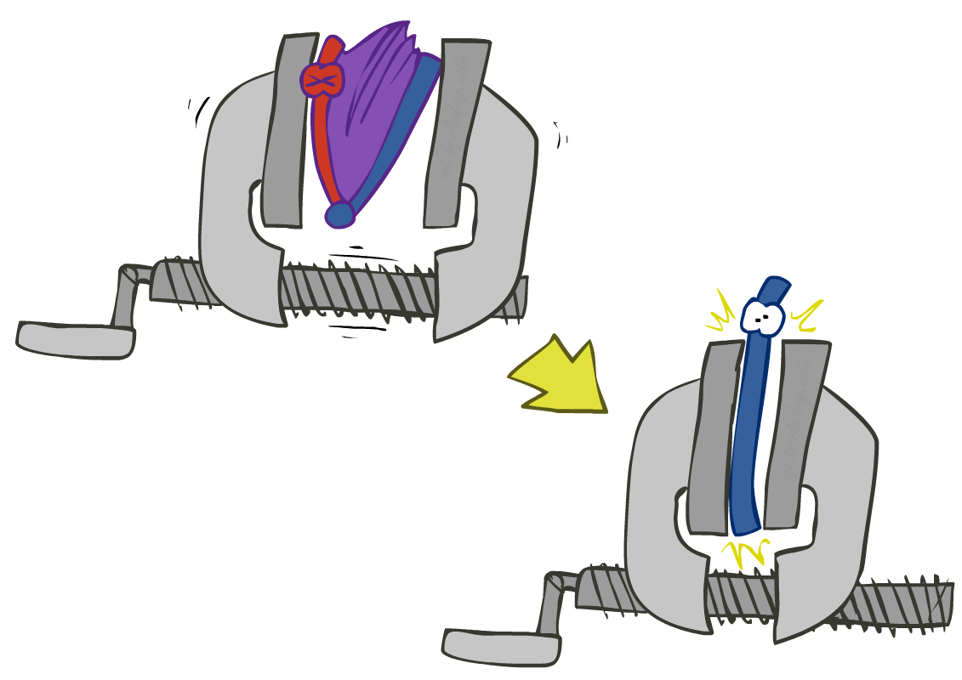


Operation 2: Eliminate
Second basic operation: marginalization
Take a factor and sum out a variable
Shrinks a factor to a smaller one
A projection operation
Example:
+r | +t | 0.08
+r | -t | 0.02
-r | +t | 0.09
-r | -t | 0.81
+t | 0.17
-t | 0.83

Slide 17



Multiple Elimination
R, T, L
T, L
L
+r | +t | +l | 0.024
+r | +t | -l | 0.056
+r | -t | +l | 0.002
+r | -t | -l | 0.018
-r | +t | +l | 0.027
-r | +t | -l | 0.063
-r | -t | +l | 0.081
-r | -t | -l | 0.729
Sum
out R
Sum
out T
+t | +l | 0.051
+t | -l | 0.119
-t | +l | 0.083
-t | -l | 0.747
+l | 0.134
-l | 0.886

Slide 18
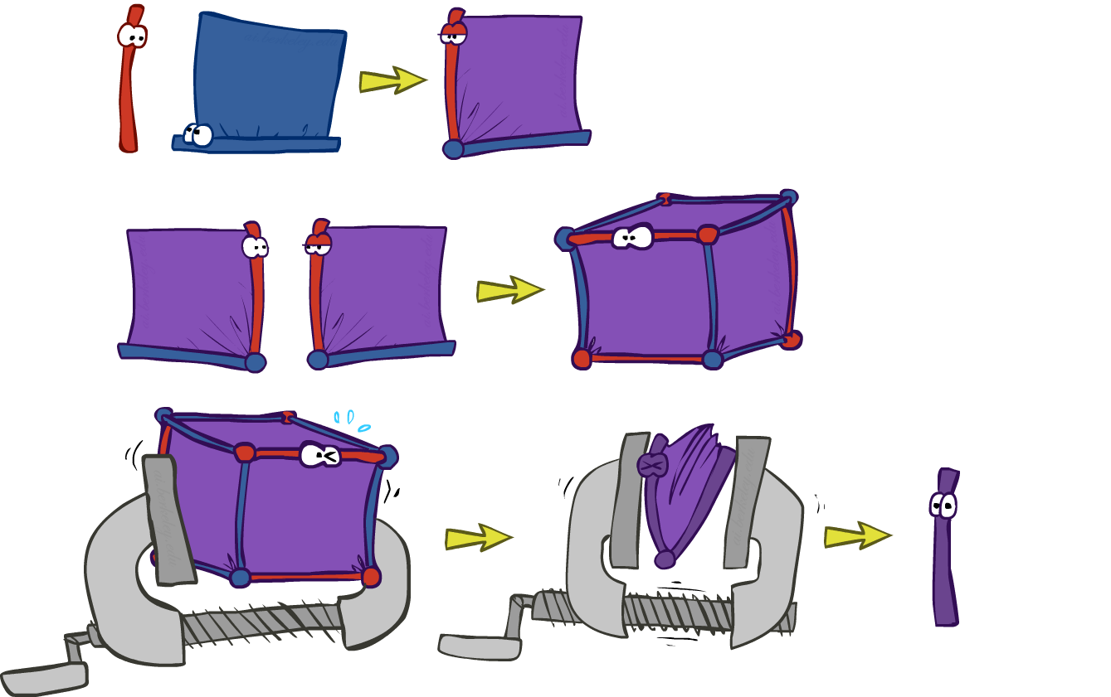
Thus Far: Multiple Join, Multiple Eliminate (= Inference by Enumeration)

Slide 19

Marginalizing Early (= Variable Elimination)

Slide 20
Traffic Domain
R
Inference by Enumeration
Variable Elimination
T
L
Join on r
Join on r
Join on t
Eliminate r
Eliminate r
Join on t
Eliminate t
Eliminate t

Slide 21


Marginalizing Early! (aka VE)
Join R
Sum out R
Join T
Sum out T
+r | +t | 0.08
+r | -t | 0.02
-r | +t | 0.09
-r | -t | 0.81
+r | 0.1
-r | 0.9
+t | 0.17
-t | 0.83
R
T
T, L
R, T
L
+r | +t | 0.8
+r | -t | 0.2
-r | +t | 0.1
-r | -t | 0.9
T
L
L
+t | +l | 0.051
+t | -l | 0.119
-t | +l | 0.083
-t | -l | 0.747
+l | 0.134
-l | 0.866
L
+t | +l | 0.3
+t | -l | 0.7
-t | +l | 0.1
-t | -l | 0.9
+t | +l | 0.3
+t | -l | 0.7
-t | +l | 0.1
-t | -l | 0.9
+t | +l | 0.3
+t | -l | 0.7
-t | +l | 0.1
-t | -l | 0.9

Slide 22
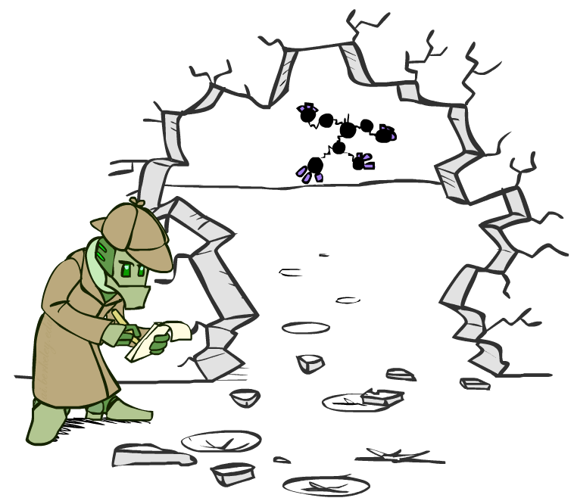



Evidence
If evidence, start with factors that select that evidence
No evidence uses these initial factors:
Computing , the initial factors become:
We eliminate all vars other than query + evidence
+r | 0.1
-r | 0.9
+r | +t | 0.8
+r | -t | 0.2
-r | +t | 0.1
-r | -t | 0.9
+t | +l | 0.3
+t | -l | 0.7
-t | +l | 0.1
-t | -l | 0.9
+r | 0.1
+r | +t | 0.8
+r | -t | 0.2
+t | +l | 0.3
+t | -l | 0.7
-t | +l | 0.1
-t | -l | 0.9

Slide 23

Evidence II
Result will be a selected joint of query and evidence
E.g. for P(L | +r), we would end up with:
To get our answer, just normalize this!
That ’s it!
Normalize
+r | +l | 0.026
+r | -l | 0.074
+l | 0.26
-l | 0.74

Slide 24

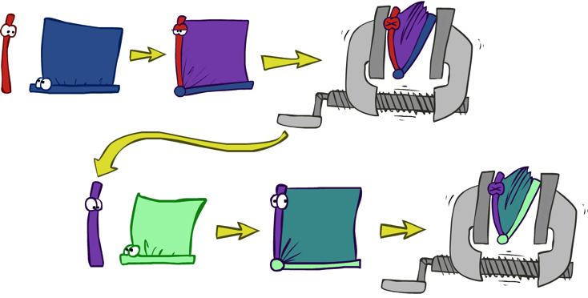


General Variable Elimination
Query:
Start with initial factors:
Local CPTs (but instantiated by evidence)
While there are still hidden variables (not Q or evidence):
Pick a hidden variable H
Join all factors mentioning H
Eliminate (sum out) H
Join all remaining factors and normalize

Slide 25
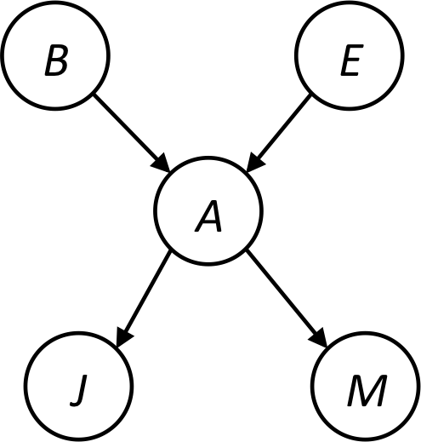









Example
Choose A

Slide 26




Example
Choose E
Finish with B
Normalize

Slide 27





Example 2: P(B|a)
Start / Select
Join on B
Normalize
B
a, B
B | P
+b | 0.1
¬b | 0.9
a
A | B | P
+a | +b | 0.08
+a | ¬b | 0.09
A | B | P
+a | +b | 8/17
+a | ¬b | 9/17
B | A | P
+b | +a | 0.8
b | ¬a | 0.2
¬b | +a | 0.1
¬b | ¬a | 0.9

Slide 28
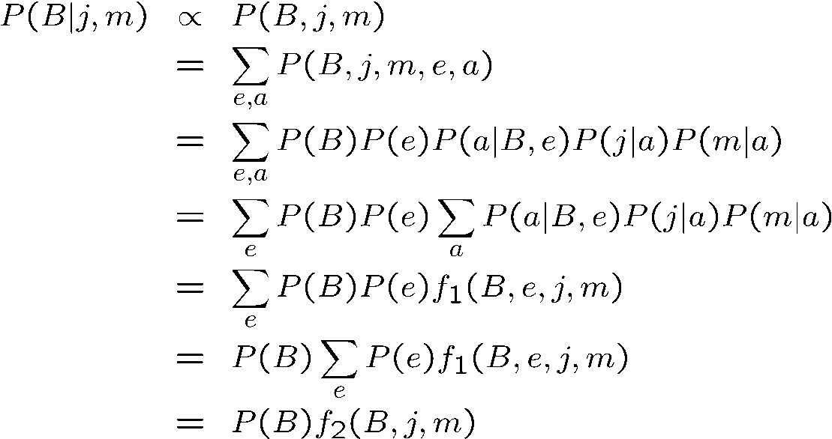
Same Example in Equations
marginal can be obtained from joint by summing out
use Bayes’ net joint distribution expression
use x*(y+z) = xy + xz
joining on a, and then summing out gives f₁
use x*(y+z) = xy + xz
joining on e, and then summing out gives f₂
All we are doing is exploiting uwy + uwz + uxy + uxz + vwy + vwz + vxy +vxz = (u+v)(w+x)(y+z) to improve computational efficiency!

Slide 29

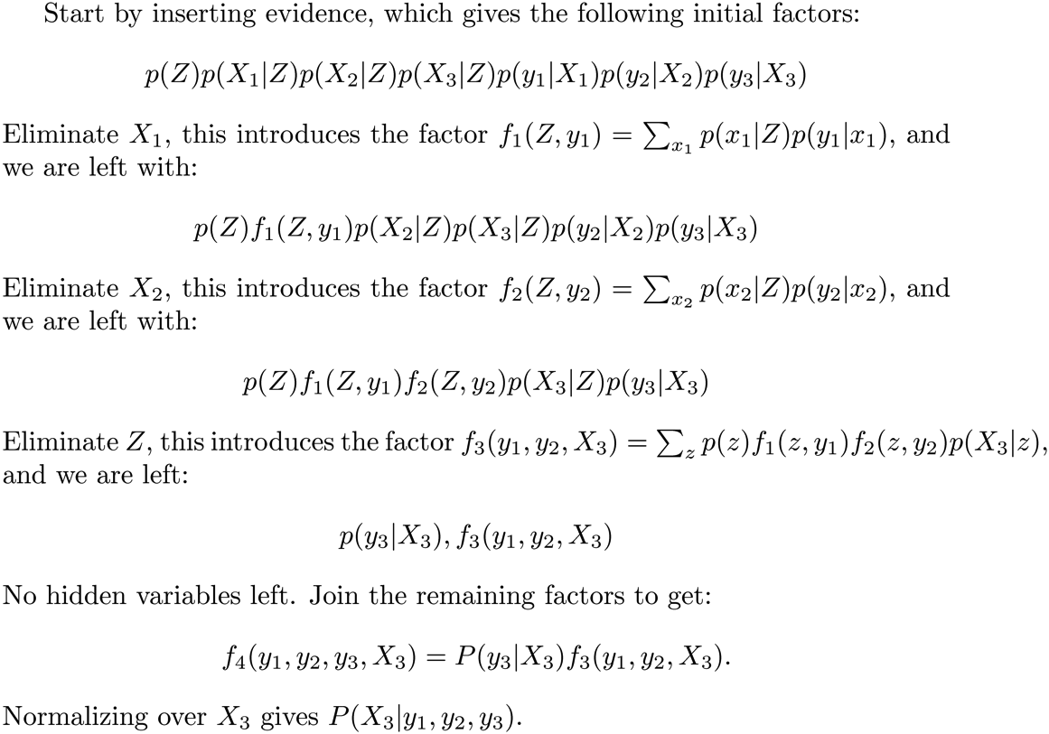






Another Variable Elimination Example
Computational complexity critically depends on the largest factor being generated in this process. Size of factor = number of entries in table. In example above (assuming binary) all factors generated are of size 2 --- as they all only have one variable (Z, Z, and X₃ respectively).

Slide 30




Variable Elimination Ordering
For the query P(X_{n}|y₁,…,y_{n}) work through the following two different orderings as done in previous slide: Z, X₁, …, X_{n-1} and X₁, …, X_{n-1}, Z. What is the size of the maximum factor generated for each of the orderings?
Answer: 2^{n+1} versus 2² (assuming binary)
In general: the ordering can greatly affect efficiency.
…
…

Slide 31
VE: Computational and Space Complexity
The computational and space complexity of variable elimination is determined by the largest factor
The elimination ordering can greatly affect the size of the largest factor.
E.g., previous slide’s example 2^{n} vs. 2
Does there always exist an ordering that only results in small factors?
No!

Slide 32

Bayes’ Nets
Representation
Conditional Independences
Probabilistic Inference
Enumeration (exact, exponential complexity)
Variable elimination (exact, worst-case exponential complexity, often better)
Inference is NP-complete
Sampling (approximate)
Learning Bayes’ Nets from Data

